Slide 1

Digital Archival Tracker - UI
Final Presentation
By
Nadeem Ansari
Rajasekhar Siravati
Suresh Reddy
Soundharya Borra
Varshitha Mittapally

Slide 2
OUTLINE
Problem statement
Overview of the solution
Deep dive in individual components
Demo
Conclusion

Slide 3

PROBLEM STATEMENT
Extremely difficult to manually read each Fixity file
Time consuming process
Difficulty in maintaining a smooth flow of information between reading each Fixity file and updating in Excel
Constantly switching between programs can be exhaustive
Strong need for streamlining the workflow

Slide 4
SOLUTION
Digital Archival Tracker has been identified as a potential solution to the problem.
Why & How?
Service Integration’s Fixity API provides a way to extract Fixity report data solving the 1st half of the problem
Extracted information is displayed to the client in a simple and clean UI
Implemented Excel-like functionality for maintaining records effectively solving the 2nd half of the problem
Eliminated the need for the client to constantly switch between apps for information flow
Designed a simple, easy to use UI to combine both the solutions together

Slide 5
OVERVIEW OF THE SOLUTION
AIP (Ongoing Preservation)
Importing & reading any Excel file
Interacting with Excel data through a UI Data Grid
Maintaining accurate records through CRUD operations using SQLite DB
Exporting to a readable format such as CSV

Slide 6
OVERVIEW OF THE SOLUTION (CONT…)
Fixity Overview
Reading practically any number of Fixity reports
Extracting vital information from Fixity reports and presenting in the UI
Identifying individual Fixity reports as projects

Slide 7
OVERVIEW OF THE SOLUTION (CONT…)
Design considerations
Ability to import and read an Excel file data dynamically
Resolution independent UI
Tabbed interface for segregated functionality
Excel-like CRUD operations straight from the UI

Slide 8
OVERVIEW OF THE SOLUTION (CONT…)
Limitations
Cannot accept spaces, special characters and symbols in column names
Does not accept multiple Fixity files with the same name
Runs on a single UI thread

Slide 9
DEEP DIVE INTO INDIVIDUAL COMPONENTS
Major app development frameworks
Major libraries for development
Data Storage
App styling
Testing

Slide 10
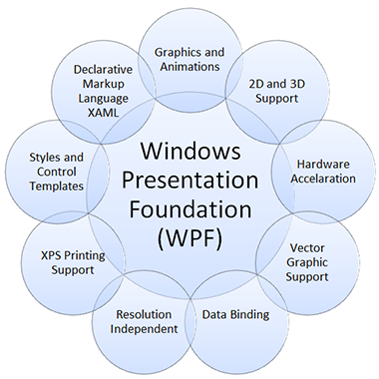
MAJOR APP DEVELOPMENT FRAMEWORK
Notes:
Windows Presentation Foundation (WPF)
Windows UI Framework for developing desktop client apps
Supports controls, graphics, layout, data binding, documents and security
Subset of .NET Framework
Uses XAML for designing User Interface

Slide 11
MAJOR LIBRARIES FOR DEVELOPMENT
2007 Office System Driver: (OLEDB)
OLEDB Driver helps with connectivity to Office file formats
Facilitated transfer of data from Office files (.xls, .xlsx etc.) to other data sources such as SQLite DB
UI Automation Library (Testing)
Functional testing of UI controls

Slide 12
DATA STORAGE
Data is stored in memory during application’s life cycle
DB team stores their information in SQLite .db file

Slide 13
APP STYLING
Default Windows application theme
XAML used to design UI components and built simultaneously with DB and Service Integration teams working on the back-end

Slide 14
TESTING
UI Automation Library in .NET 4.5
Functional testing of UI controls
Useful for carrying out validations or other logic in UI
Testing of text fields, buttons, data grids and combo boxes

Slide 15
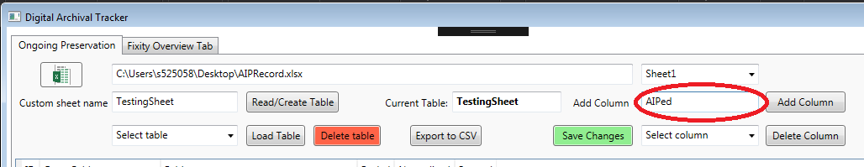
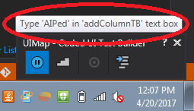
TESTING (EXAMPLE – TEXT FIELD)

Slide 16
DEMO

Slide 17
CONCLUSION
Developed Windows desktop application for simplified tracking of archived files
Application scans Fixity reports and presents the information in a simple and easy to use interface for Fixity Overview tab
Provides Excel-like functionality for maintaining accurate records of archived files in Ongoing Preservation tab
Enables exporting of OnGoing Preservation data to very common file format such as CSV

Slide 18
CONCLUSION (CONT…)
Application handles table data carefully and no overlapping of data
Developed with strong collaboration between different teams
App has been tested rigorously
Handling edge cases and errors critical for deployment
Worked closely with DB team to incorporate Ongoing Preservation features such as table creation, CRUD operations etc.
Developing applications using WPF is easy

Slide 19
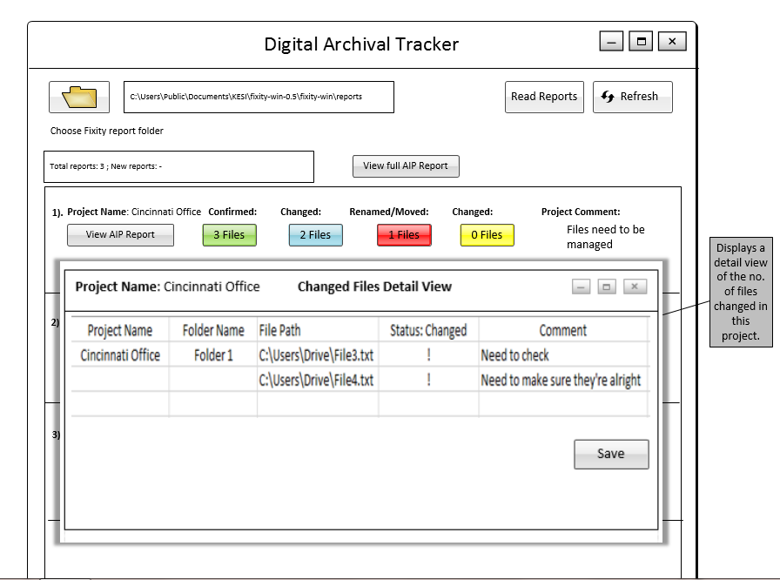
PLANNED VIEW OF THE SYSTEM

Slide 20
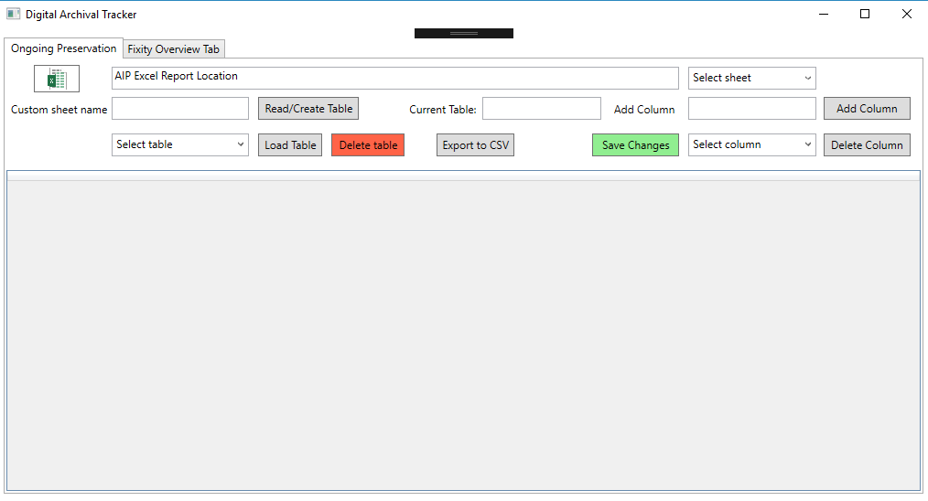
PRESENT VIEW OF THE SYSTEM

Slide 21
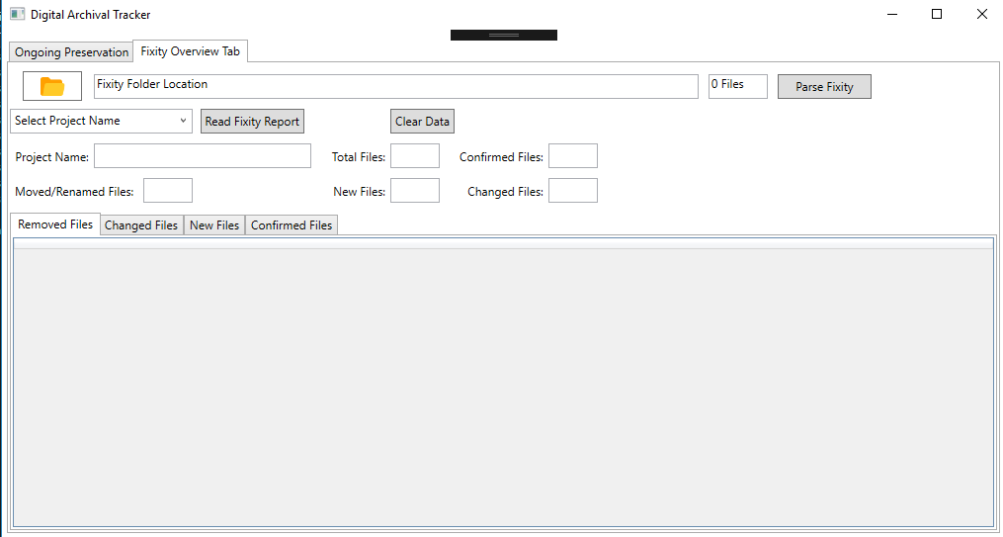
PRESENT VIEW OF THE SYSTEM

Slide 22
THANK YOU ANY QUESTIONS?

